Slide 1
Stacks
Chapter 7
Notes:
1

Slide 2
Chapter Contents
Introduction
Linear (Array) Stack Implementation
Linked Stack Implementation
Stack Implementation: Derived Class

Slide 3
Objectives
Learn how to implement a stack as a derived class
Test the derived-class implementation of stacks using postfix expression evaluation

Slide 4
Stacks are Restricted Linked Lists
Recall that the stack data structure allows elements to be added to the stack and removed from the stack only at the top
Thus, a stack can be implemented as a constrained version of a linked list
In such implementation, the link member in the last node is set to null (zero) to indicate the bottom of the stack

Slide 5
Using Inheritance
We will take advantage of the close relationship between lists and stacks to implement a stack class primarily by reusing a list class
We can implement the stack class through:
public inheritance of the list class
private Inheritance of the list class
Then we implement an identically performing stack class through composition by including a list object as a private member of a stack class

Slide 6
Recall: In public Inheritance
All public members in the base class become public in the derived class and can be accessed directly by member functions, friend functions, and nonmember functions.
All protected members in the base class become protected in the derived class and can be accessed directly by member functions and friend functions.
All private members in the base class are hidden in the derived class and can be accessed by member functions and friend functions through public or protected member functions of the base class.

Slide 7
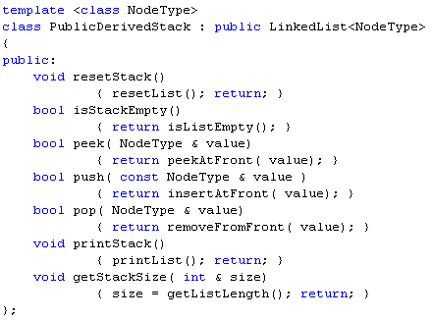
The PublicDerivedStack Class

Slide 8
The PublicDerivedStack Class
Stack member functions are essentially the same as certain list class member functions
So, each stack member function is implemented through a function call to the correspondent list member function

Slide 9
Public Items are Public and Can be Accessed by None-Member Functions
Of course, the list class contains other member functions that we would NOT want to make accessible through the public interface of the stack class
Public inheritance does not prevent such access!

Slide 10
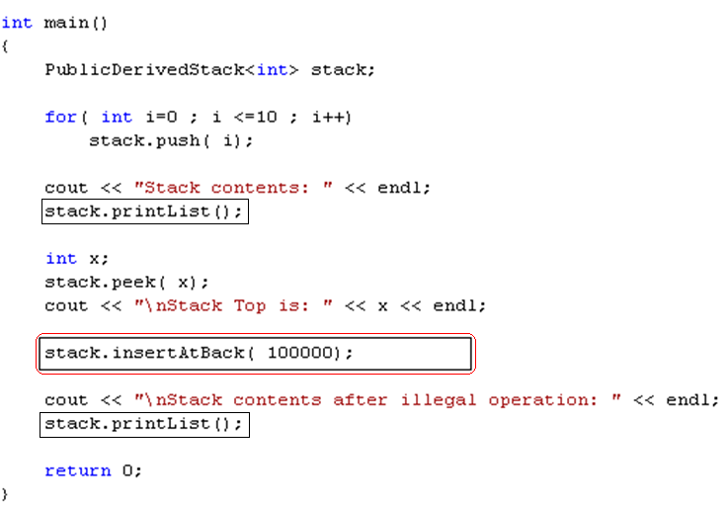
An Illegal Operation for Stacks!

Slide 11
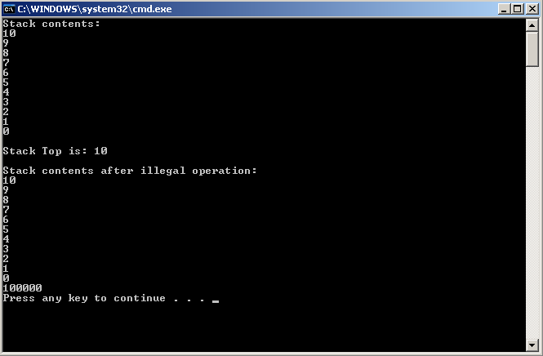
An Illegal Operation for Stacks!

Slide 12
Recall: In private Inheritance
All public and protected members in the base class become private in the derived class and can be accessed directly only by member functions and friend functions.
All private members in the base class are hidden in the derived class and can be accessed by member functions and friend functions through public or protected member functions of the base class.
Hence, private inheritance disallows illegal operations on stacks

Slide 13
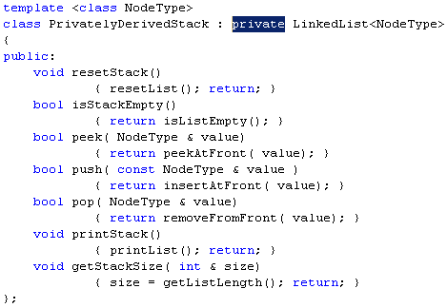
The PrivatelyDerivedStack Class

Slide 14
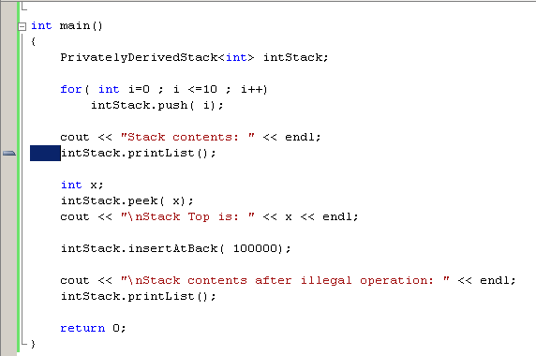
Public Items are Private and Cannot be Accessed by None-Member Functions

Slide 15
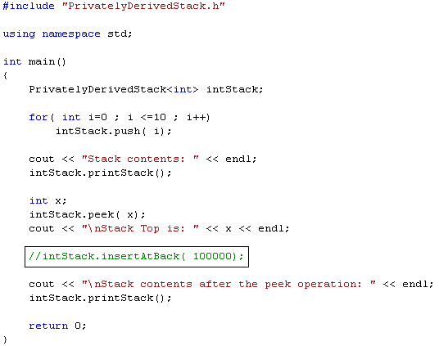
Private Inheritance Prevents Illegal Operations on Stacks!

Slide 16
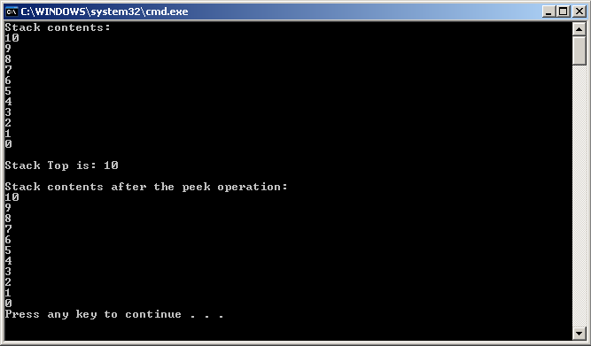
No Illegal Operations!

Slide 17
Stack Class Through Composition
Include a list object as a private data member
Call appropriate member functions through this list object

Slide 18
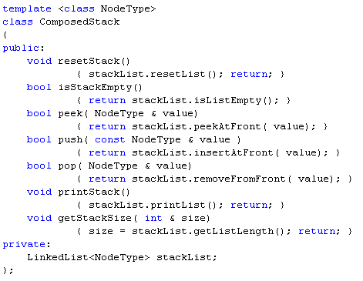
The ComposedStack Class

Slide 19
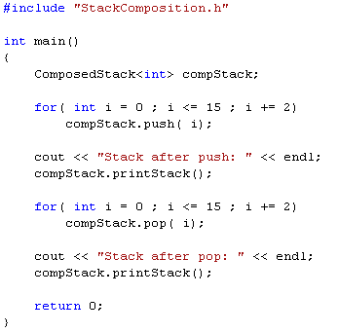
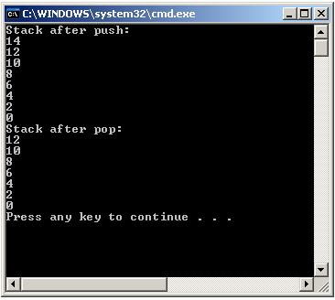
Testing the ComposedStack Class

Slide 20
Infix and Postfix Notations
An arithmetic expression can be written in three ways:
+ a b (Prefix Notation)
a + b (Infix Notation)
a b + (Postfix Notation)
Humans like to use infix notation
More natural, what we use in grammar school
Computers prefer postfix notation
No need to use parentheses
No need to implement precedence rules

Slide 21
Infix to Postfix Conversion
In high level languages, infix notation cannot be used to evaluate expressions:
We must analyze the expression to determine the order in which we evaluate it.
Computers prefer postfix notation
No need to use parentheses
No need to implement precedence rules
A common technique is to convert an expression from infix notation into postfix notation, then evaluating it.

Slide 22
Infix to Postfix Conversion Rules
Operands immediately go directly to output
Operators are pushed into the stack (including parenthesis)
Check to see if stack top operator is less than current operator
If the top operator is less than, push the current operator onto stack
If the top operator is greater than the current, pop top operator and output it, push current operator onto stack
Priority 2: * /
Priority 1: + -
Priority 0: (
If we encounter a right parenthesis, pop from stack until we get matching left parenthesis. Do not output parenthesis.

Slide 23
Stacks Use in Compilers: Converting Infix to Postfix Example 1
A + B * C - D / E
Infix Stack(bottom->top) Postfix
A + B * C - D / E
+ B * C - D / E A
B * C - D / E + A
* C - D / E + A B
C - D / E + * A B
- D / E + * A B C
D / E + - A B C *
/ E + - A B C * D
E + - / A B C * D
+ - / A B C * D E
A B C * D E / - +

Slide 24
Stacks Use in Compilers: Converting Infix to Postfix Example 2
A * B - ( C + D ) + E
Infix Stack(bottom->top) Postfix
A * B - ( C - D ) + E empty empty
* B - ( C + D ) + E empty A
B - ( C + D ) + E * A
- ( C + D ) + E * A B
- ( C + D ) + E empty A B *
( C + D ) + E - A B *
C + D ) + E - ( A B *
+ D ) + E - ( A B * C
D ) + E - ( + A B * C
) + E - ( + A B * C D
+ E - A B * C D +
+ E empty A B * C D + -
E + A B * C D + -
+ A B * C D + - E
empty A B * C D + - E +

Slide 25
Stacks Use in Compilers: Postfix Evaluation Rules
Operands are pushed on the stack
If an operator is encountered:
Pop the top two operands from the stack
Do the math
Push result back onto stack

Slide 26
Stacks Use in Compilers: Postfix Evaluation: Example 1
1 2 3 + *
Postfix Stack( bottom -> top )
1 2 3 + * empty
2 3 + * 1
3 + * 1 2
+ * 1 2 3
1 2 // Pop 3
1 // Pop 2
// Add 2 + 3
1 5 // 5 from 2 + 3
1 // Pop 5
empty // Pop 1
5 // 5 from 1 * 5

Slide 27
Stacks Use in Compilers: Postfix Evaluation: Example 2
Postfix expression: 6 3 + 2 * =

Slide 28
Section 4 and Chapter 7 - End

